Slide 1
Database Recovery

Slide 2
Outline
Databases Recovery
1 Purpose of Database Recovery
2 Types of Failure
3 Transaction Log
4 Data Updates
5 Data Caching
6 Transaction Roll-back (Undo) and Roll-Forward
7 Check pointing
8 Recovery Techniques / schemes

Slide 3
1 Purpose of Database Recovery
    To bring the database into the last consistent state, which existed prior to the failure.
    To preserve transaction properties (Atomicity, Consistency, Isolation and Durability).
  Example: If the system crashes before a fund transfer transaction completes its execution, then either one or both accounts may have incorrect value. Thus, the database must be restored to the state before the transaction modified any of the accounts.

Slide 4
2 Types of Failure
  The database may become unavailable for use due to
  Transaction failure: Transactions may fail because of incorrect input, deadlock, incorrect synchronization.
  System failure: System may fail because of addressing error, application error, operating system fault, RAM failure, etc.
  Media failure: Disk head crash, power disruption, etc.

Slide 5
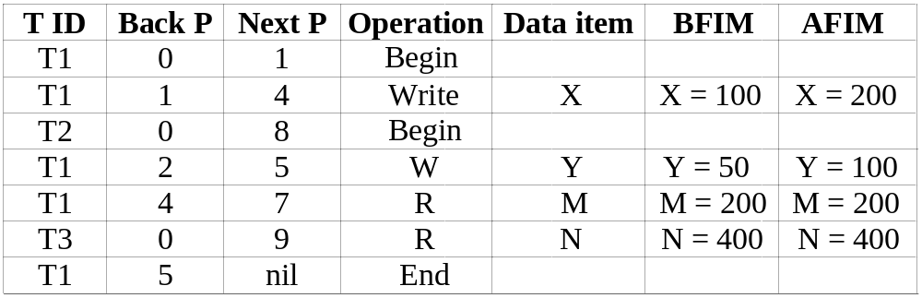
3 Transaction Log
  For recovery from any type of failure data values prior to modification (BFIM - BeFore Image) and the new value after modification (AFIM – AFter Image) are required. These values and other information is stored in a sequential file called Transaction log. A sample log is given below. Back P and Next P point to the previous and next log records of the same transaction.
Chapter 19-<number>

Slide 6
4 Data Update
  Immediate Update: As soon as a data item is modified in cache, the disk copy is updated. (UNDO/NO-REDO)
  Deferred Update: All modified data items in the cache is written either after a transaction ends its execution or after a fixed number of transactions have completed their execution. (NO-UNDO/REDO)
  Shadow update: The modified version of a data item does not overwrite its disk copy but is written at a separate disk location.
  In-place update: The disk version of the data item is overwritten by the cache version.
Chapter 19-<number>

Slide 7
5 Data Caching
  Data items to be modified are first stored into database cache by the Cache Manager (CM) and after modification they are flushed (written) to the disk. The flushing is controlled by Modified and Pin-Unpin bits.
  Pin-Unpin: Instructs the operating system not to flush the data item.
  Modified: Indicates the AFIM of the data item.

Slide 8
6 Transaction Roll-back (Undo) and Roll-Forward (Redo)
  To maintain atomicity, a transaction’s operations are redone or undone.
  Undo: Restore all BFIMs on to disk (Remove all AFIMs).
  Redo: Restore all AFIMs on to disk.
  Database recovery is achieved either by performing only Undo’s or only Redo’s or by a combination of the two. These operations are recorded in the log as they happen.
Chapter 19-<number>

Slide 9
Roll-back
We show the process of roll-back with the help of the following three transactions T1, and T2 and T3.
  T1 T2 T3
  read_item (A) read_item (B) read_item (C)
  read_item (D) write_item (B) write_item (B)
  write_item (D) read_item (D) read_item (A)
  write_item (A) write_item (A)
Chapter 19-<number>

Slide 10
Roll-back: One execution of T1, T2 and T3 as recorded in the log.
A B C D
30 15 40 20
  [start_transaction, T3]
  [read_item, T3, C]
  * [write_item, T3, B, 15, 12] 12
  [start_transaction,T2]
  [read_item, T2, B]
  ** [write_item, T2, B, 12, 18] 18
  [start_transaction,T1]
  [read_item, T1, A]
  [read_item, T1, D]
  [write_item, T1, D, 20, 25] 25
  [read_item, T2, D]
  ** [write_item, T2, D, 25, 26] 26
  [read_item, T3, A]
  ---- system crash ----
  * T3 is rolled back because it did not reach its commit point.
  ** T2 is rolled back because it reads the value of item B written by T3.
Chapter 19-<number>

Slide 11
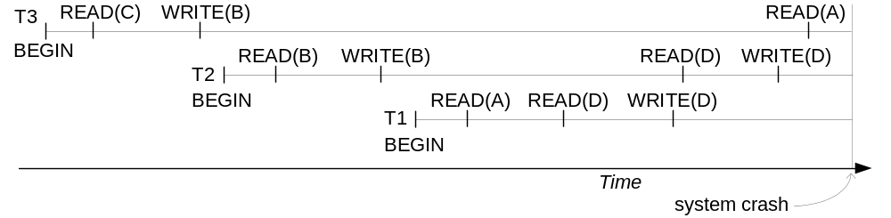
Database Recovery
Roll-back: One execution of T1, T2 and T3 as recorded in the log.
Illustrating cascading roll-back
Chapter 19-<number>

Slide 12
Write-Ahead Logging
  When in-place update (immediate or deferred) is used then log is necessary for recovery and it must be available to recovery manager. This is achieved by Write-Ahead Logging (WAL) protocol. WAL states that
  For Undo: Before a data item’s AFIM is flushed to the database disk (overwriting the BFIM) its BFIM must be written to the log and the log must be saved on a stable store (log disk).
  For Redo: Before a transaction executes its commit operation, all its AFIMs must be written to the log and the log must be saved on a stable store.
* WAL – Write ahead Logging is a popular method among database users to preserve the atomicity and durability of their data writes. This technique operates on the concept of logging your data writes in secure storage prior to making any permanent changes in your database
Chapter 19-<number>

Slide 13
7 Check pointing
  Time to time (randomly or under some criteria) the database flushes its buffer to database disk to minimize the task of recovery. The following steps defines a checkpoint operation:
  Suspend execution of transactions temporarily.
  Force write modified buffer data to disk.
  Write a [checkpoint] record to the log, save the log to disk.
  Resume normal transaction execution.
  During recovery redo or undo is required to transactions appearing after [checkpoint] record.
Chapter 19-<number>

Slide 14
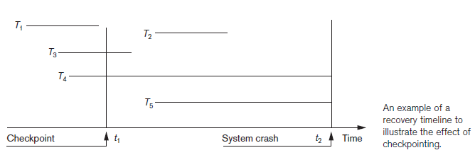
Chapter 19-<number>

Slide 15
Steal/No-Steal and Force/No-Force
  Possible ways for flushing database cache to database disk:
  Steal: Cache can be flushed before transaction commits.
  No-Steal: Cache cannot be flushed before transaction commit.
  Force: Cache is immediately flushed (forced) to disk.
  No-Force: Cache is deferred until transaction commits.
  These give rise to four different ways for handling recovery:
  -Steal/No-Force (Undo/Redo),
  -Steal/Force (Undo/No-redo),
  -No-Steal/No-Force (No-undo/Redo) and
  -No-Steal/Force (No-undo/No-redo).
Chapter 19-<number>

Slide 16
8 Recovery Techniques / Scheme
(i) Deferred Update (No Undo/Redo)
  The data update goes as follows:
  A set of transactions records their updates in the log.
  At commit point under WAL scheme these updates are saved on database disk.
After reboot from a failure the log is used to redo all the transactions affected by this failure.
No undo is required because no AFIM is flushed to the disk before a transaction commits.
Chapter 19-<number>

Slide 17
  (I a) Deferred Update in a single-user system
There is no concurrent data sharing in a single user system. The data update goes as follows:
  A set of transactions records their updates in the log.
  At commit point under WAL scheme these updates are saved on database disk.
After reboot from a failure the log is used to redo all the transactions affected by this failure.
No undo is required because no AFIM is flushed to the disk before a transaction commits.
Chapter 19-<number>

Slide 18
  Deferred Update in a single-user system with concurrent transaction
(a) T1 T2
  read_item (A) read_item (B)
  read_item (D) write_item (B)
  write_item (D) read_item (D)
  write_item (A)
(b)
  [start_transaction, T1]
  [write_item, T1, D, 20]
  [commit T1]
  [start_transaction, T2]
  [write_item, T2, B, 10]
  [write_item, T2, D, 25] ← system crash
  The [write_item, …] operations of T1 are redone because its commit point is after the last system checkpoint.
  T2 log entries are ignored by the recovery manager they did not reach their commit points..
Chapter 19-<number>

Slide 19
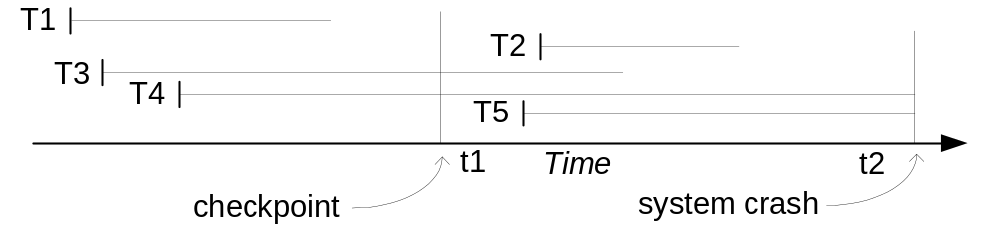
  (I b) Deferred Update with concurrent users
This environment requires some concurrency control mechanism to guarantee isolation property of transactions. In a system recovery transactions which were recorded in the log after the last checkpoint were redone. The recovery manager may scan some of the transactions recorded before the checkpoint to get the AFIMs.
Recovery in a concurrent users environment.

Slide 20
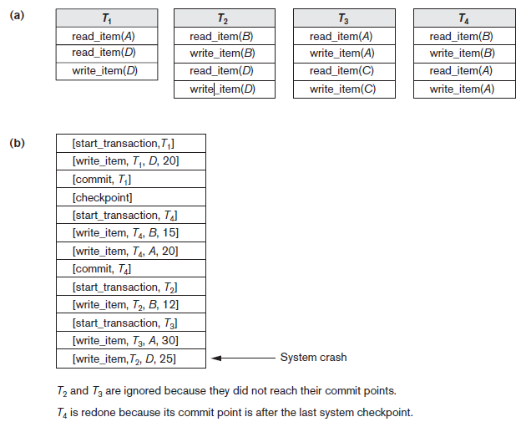
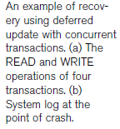
  Deferred Update with concurrent users
Chapter 19-<number>

Slide 21
  Deferred Update with concurrent users
Two tables are required for implementing this protocol:
Active table: All active transactions are entered in this table.
Commit table: Transactions to be committed are entered in this table.
During recovery, all transactions of the commit table are redone and all transactions of active tables are ignored since none of their AFIMs reached the database. It is possible that a commit table transaction may be redone twice but this does not create any inconsistency because of a redone is “idempotent”, that is, one redone for an AFIM is equivalent to multiple redone for the same AFIM.

Slide 22
II ) Recovery Techniques Based on Immediate Update
Theoretically, we can distinguish two main categories of immediate update algorithms.
If the recovery technique ensures that all updates of a transaction are recorded in the database on disk before the transaction commits, there is never a need to REDO any operations of committed transactions.
This is called the UNDO/NO-REDO recovery algorithm.
In this method, all updates by a transaction must be recorded on disk before the transaction commits, so that REDO is never needed.
Hence, this method must utilize the force strategy for deciding when updated main memory buffers are written back to disk.
If the transaction is allowed to commit before all its changes are written to the database, we have the most general case, known as the UNDO/REDO recovery algorithm. In this case, the steal/no-force strategy is applied.

Slide 23
  Recovery Techniques Based on Immediate Update
  A) Undo/No-redo Algorithm
In this algorithm AFIMs of a transaction are flushed to the database disk under WAL before it commits.
For this reason the recovery manager undoes all transactions during recovery.
No transaction is redone.
It is possible that a transaction might have completed execution and ready to commit but this transaction is also undone.

Slide 24
  Recovery Techniques Based on Immediate Update
  B) Undo/Redo Algorithm (Single-user environment)
  Recovery schemes of this category apply undo and also redo for recovery. In a single-user environment no concurrency control is required but a log is maintained under WAL. Note that at any time there will be one transaction in the system and it will be either in the commit table or in the active table. The recovery manager performs:
  Undo of a transaction if it is in the active table.
  Redo of a transaction if it is in the commit table.

Slide 25
  Recovery Techniques Based on Immediate Update
  C) Undo/Redo Algorithm (Concurrent execution)
  Recovery schemes of this category applies undo and also redo to recover the database from failure. In concurrent execution environment a concurrency control is required and log is maintained under WAL. Commit table records transactions to be committed and active table records active transactions. To minimize the work of the recovery manager checkpointing is used. The recovery performs:
  Undo of a transaction if it is in the active table.
  Redo of a transaction if it is in the commit table.

Slide 26
Procedure RIU_M (UNDO/REDO with checkpoints).
  1. Use two lists of transactions maintained by the system: the committed transactions since the last checkpoint and the active transactions.
  2. Undo all the write_item operations of the active (uncommitted) transactions, using the UNDO procedure. The operations should be undone in the reverse of the order in which they were written into the log.
  3. Redo all the write_item operations of the committed transactions from the log, in the order in which they were written into the log, using the REDO procedure defined earlier.

Slide 27
The UNDO procedure is defined as follows:
Procedure UNDO (WRITE_OP).
  Undoing a write_item operation write_op consists of examining its log entry
  [write_item, T, X, old_value, new_value] and setting the value of item X in the database to old_value, which is the before image (BFIM).
  Undoing a number of write_item operations from one or more transactions from the log must proceed in the reverse order from the order in which the operations were written in the log.

Slide 28
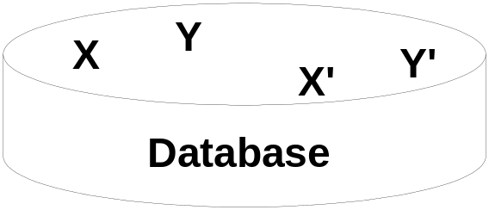
  III) Shadow Paging
  The AFIM does not overwrite its BFIM but recorded at another place on the disk. Thus, at any time a data item has AFIM and BFIM (Shadow copy of the data item) at two different places on the disk.
X and Y: Shadow copies of data items
X` and Y`: Current copies of data items

Slide 29
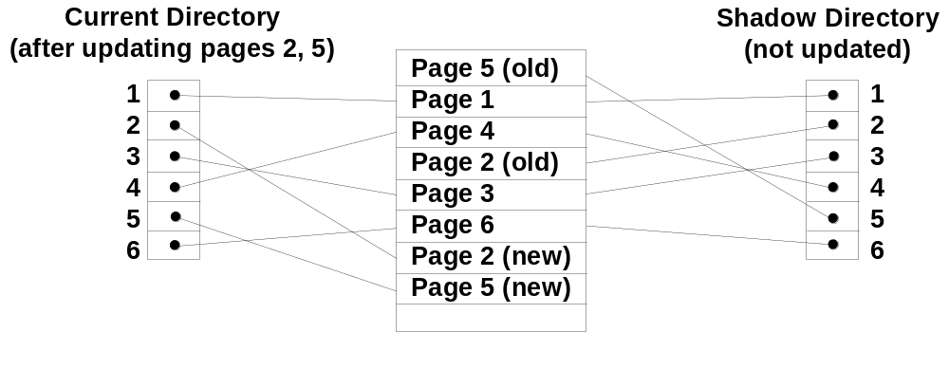
  Shadow Paging
  To manage access of data items by concurrent transactions two directories (current and shadow) are used. The directory arrangement is illustrated below. Here a page is a data item.

Slide 30
Shadow Paging is recovery technique that is used to recover database.
In this recovery technique, database is considered as made up of fixed size of logical units of storage which are referred as pages.
Pages are mapped into physical blocks of storage, with help of the page table which allow one entry for each logical page of database.
This method uses two page tables named current page table and shadow page table.
The entries which are present in current page table are used to point to most recent database pages on disk.

Slide 31
Another table (i.e., Shadow page table) is used when the transaction starts which is copying current page table.
After this, shadow page table gets saved on disk and current page table is going to be used for transaction.
Entries present in current page table may be changed during execution but in shadow page table it never get changed.
After transaction, both tables become identical. This technique is also known as Cut-of-Place updating.

Slide 32
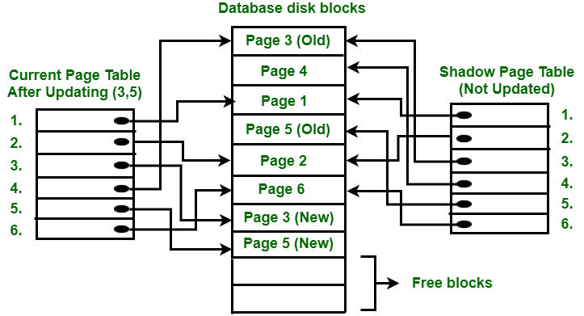
To understand concept, consider above figure. In this 2 write operations are performed on page 3 and 5. Before start of write operation on page 3, current page table points to old page 3.

Slide 33
When write operation starts following steps are performed :
  Firstly, search start for available free block in disk blocks.
  After finding free block, it copies page 3 to free block which is represented by Page 3 (New).
  Now current page table points to Page 3 (New) on disk but shadow page table points to old page 3 because it is not modified.
  The changes are now propagated to Page 3 (New) which is pointed by current page table.

Slide 34
COMMIT Operation : To commit transaction following steps should be done :
  All the modifications which are done by transaction which are present in buffers are transferred to physical database.
  Output current page table to disk.
  Disk address of current page table output to fixed location which is in stable storage containing address of shadow page table.
  This operation overwrites address of old shadow page table.
  With this current page table becomes same as shadow page table and transaction is committed.

Slide 35
Failure :
  If system crashes during execution of transaction but before commit operation, With this, it is sufficient only to free modified database pages and discard current page table.
  Before execution of transaction, state of database get recovered by reinstalling shadow page table.
    If the crash of system occur after last write operation then it does not affect propagation of changes that are made by transaction.
    These changes are preserved and there is no need to perform redo operation.

Slide 36
Advantages :
This method require fewer disk accesses to perform operation.
In this method, recovery from crash is inexpensive and quite fast.
There is no need of operations like- Undo and Redo.
Recovery using this method will be faster.
Improved fault tolerance
Increased concurrency
Simplicity
No need for log files

Slide 37
Disadvantages :
Due to location change on disk due to update database it is quite difficult to keep related pages in database closer on disk.
During commit operation, changed blocks are going to be pointed by shadow page table which have to be returned to collection of free blocks otherwise they become accessible.
The commit of single transaction requires multiple blocks which decreases execution speed.
To allow this technique to multiple transactions concurrently it is difficult.
Data fragmentation
Garbage collection
Performance overhead
Limited concurrency control
Difficult to implement for some systems
Limited fault tolerance

Slide 38
Thank you

